Slide 1
Set Operations
Chapter 2

Slide 2
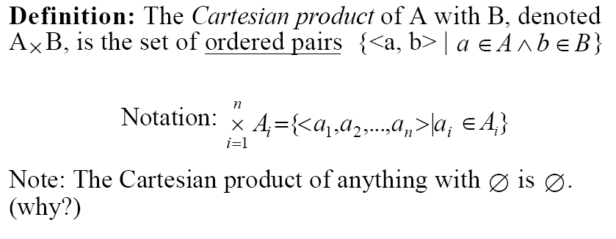
Cartesian

Slide 3
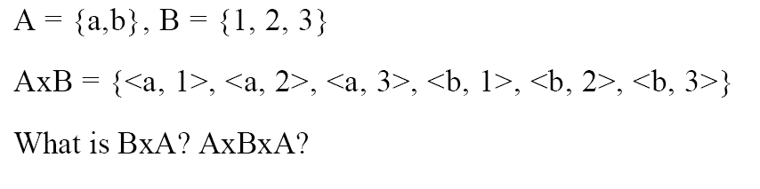
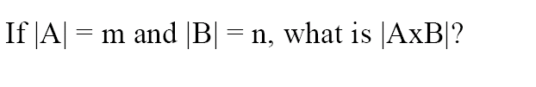
Example

Slide 4
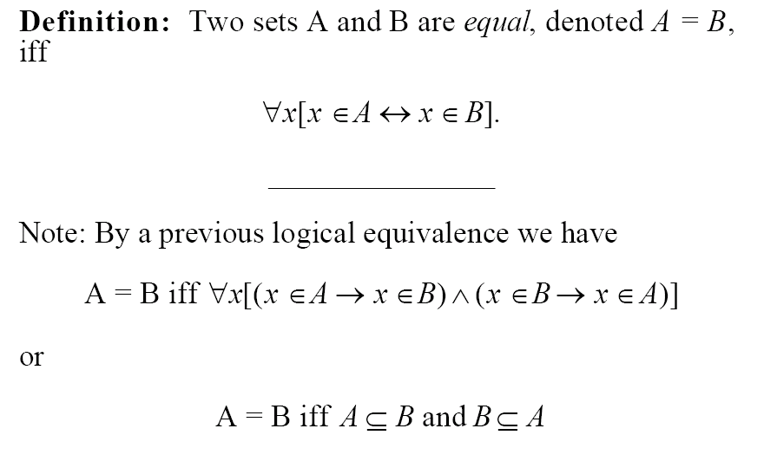
Equality

Slide 5
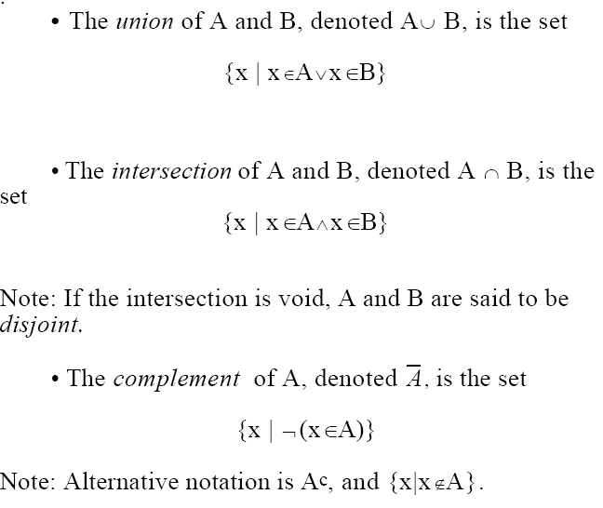
Definitions

Slide 6
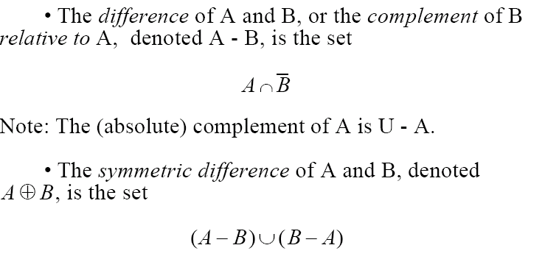
More Definitions

Slide 7
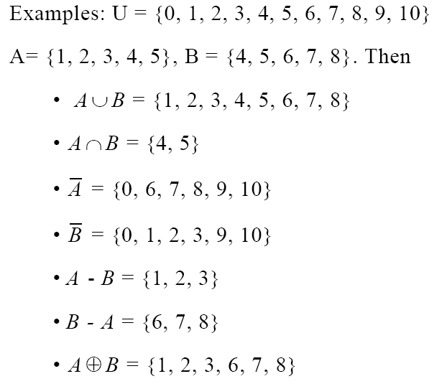
Example

Slide 8
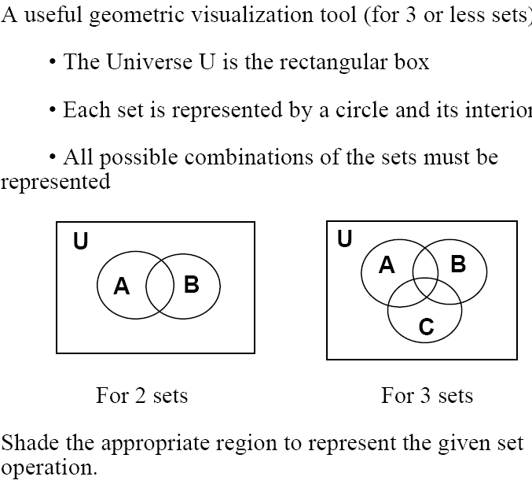
Venn Diagrams

Slide 9
Venn Diagrams Examples
What about intersection?

Slide 10
Venn Diagrams Examples
What about complement?

Slide 11
Venn Diagrams Examples
What about set difference?

Slide 12
Venn Diagrams Examples
What about symmetric difference?

Slide 13
Venn Diagrams Examples
Can you express symmetric difference using only union, intersection, and complement?

Slide 14
Set Identities
Identity | Name
 | Identity Laws
 | Domination Laws
 | Idempotent Laws
 | Complement Laws
 | Commutative Laws

Slide 15
some more …
Identity | Name
 | Associative laws
 | Distributive laws
 | DeMorgan’s laws
 | Absorption laws
 | Complement laws

Slide 16
How to prove set identities?
Several methods:
Use basic definition of sets, and apply logic
Use existing set identities
Use set table membership

Slide 17
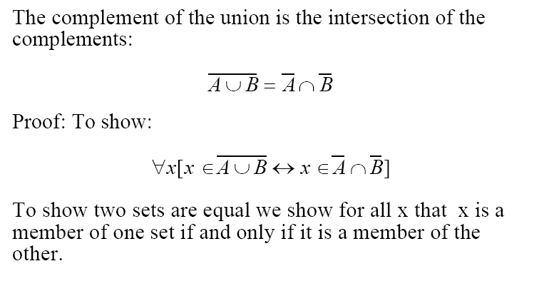
Example with definitions and logic

Slide 18
continued…
We will use “universal generalization”
We will perform our proof of P(x) using an “arbitrary” x
Since we did not assume anything specific about x, we can then conclude that
∀x P(x)

Slide 19
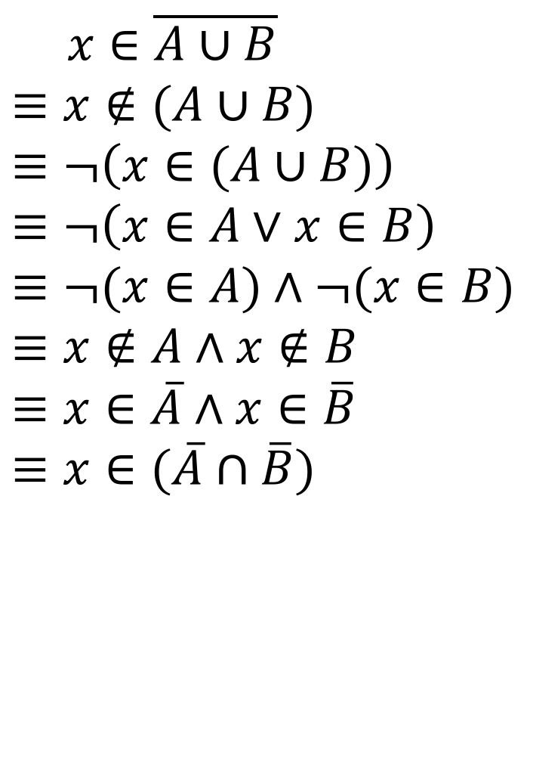
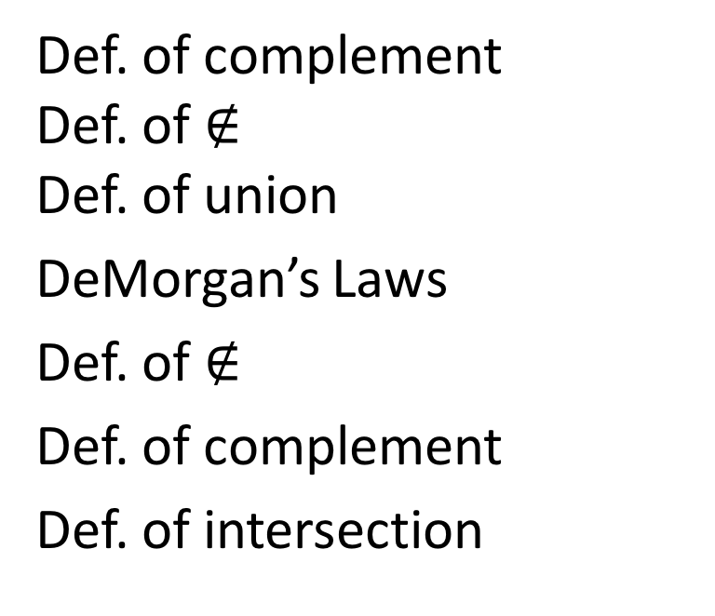
$$x∈\overline{A∪B} \\ ≡x∉(A∪B)$$
$$≡¬\left(x∈(A∪B)\right) \\ ≡¬\left(x∈A∨x∈B\right) \\ ≡¬(x∈A)∧¬(x∈B) \\ ≡x∉A∧x∉B \\ ≡x∈\overline{A}∧x∈\overline{B} \\ ≡x∈(\overline{A}∩\overline{B})$$
Def. of complement Def. of $∉$ Def. of union
DeMorgan’s Laws
Def. of $∉$
Def. of complement
Def. of intersection

Slide 20
Example using set identities
Show that A – B =
De Morgan’s laws
= Distributive Rule
= Complement Law
= Identity Law
= Definition of difference
=

Slide 21
Membership Table
A B
1 1 1 0 0 1 0 0 | 1 1 1 0 | 0 0 1 1 | 0 1 0 1 | 0 0 0 1 | 0 0 0 1

Slide 22
Computer Representation
Assume that the universal set U is finite and a reasonable size n.
Order the set.
Represent a subset A of U to be the bit string of length n which has a 1 in the i^{th} position if the i^{th} element in the ordering is in set A and a 0 otherwise.

Slide 23
Example
U = {1,2,3,4,5,6,7,8,9,10} be ordered in the usual fashion.
The set S = {1,5,8}
Has the representation
1000100100

Slide 24
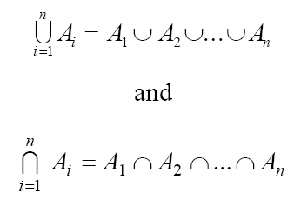
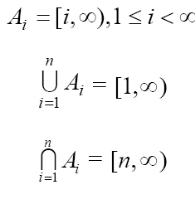
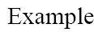
Union and Intersection of Indexed Collections

